Slide 1
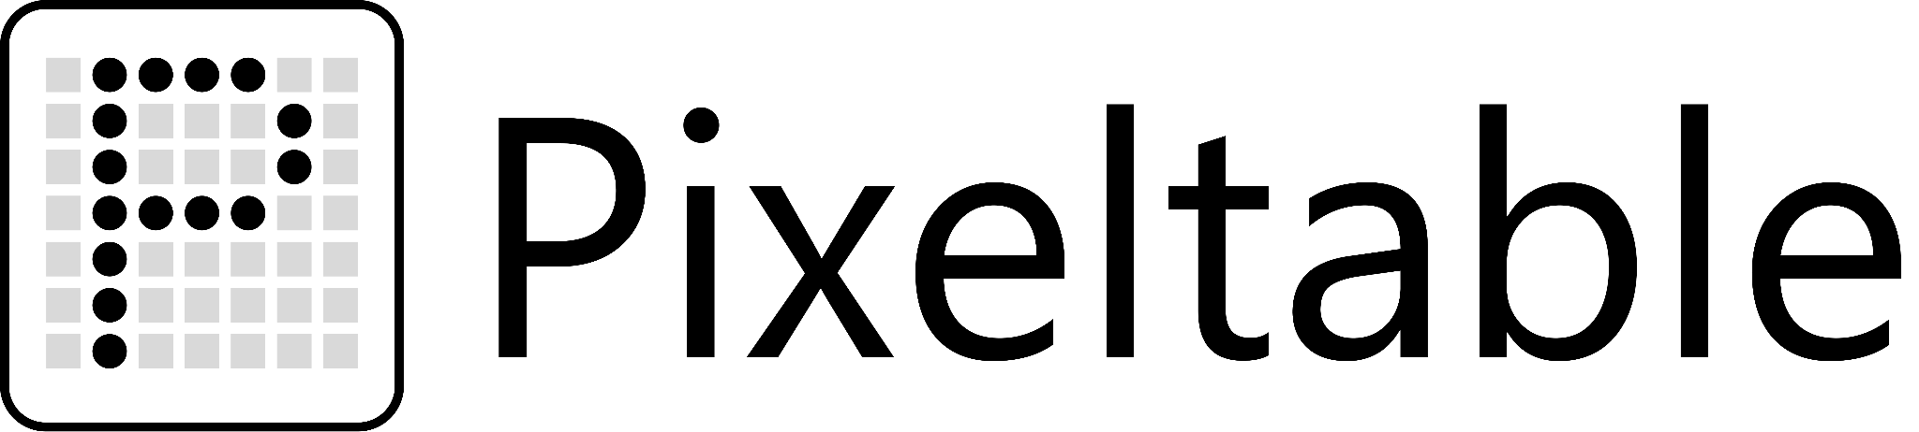
Open-Source Data Infrastructure for Multimodal AI
November 6 2025
Marcel Kornacker

Slide 2

About me
Co-founder & CTO, Pixeltable
UC Berkeley: PhD in Database Systems (advisor: Joe Hellerstein)
Google (2003-2010): Tech lead for F1 database, worked on scalable data infrastructure
Cloudera:
Co-creator of Apache Parquet
Created Apache Impala (first database to use LLVM for runtime code generation)

Slide 3
The problem with AI development today

Slide 4
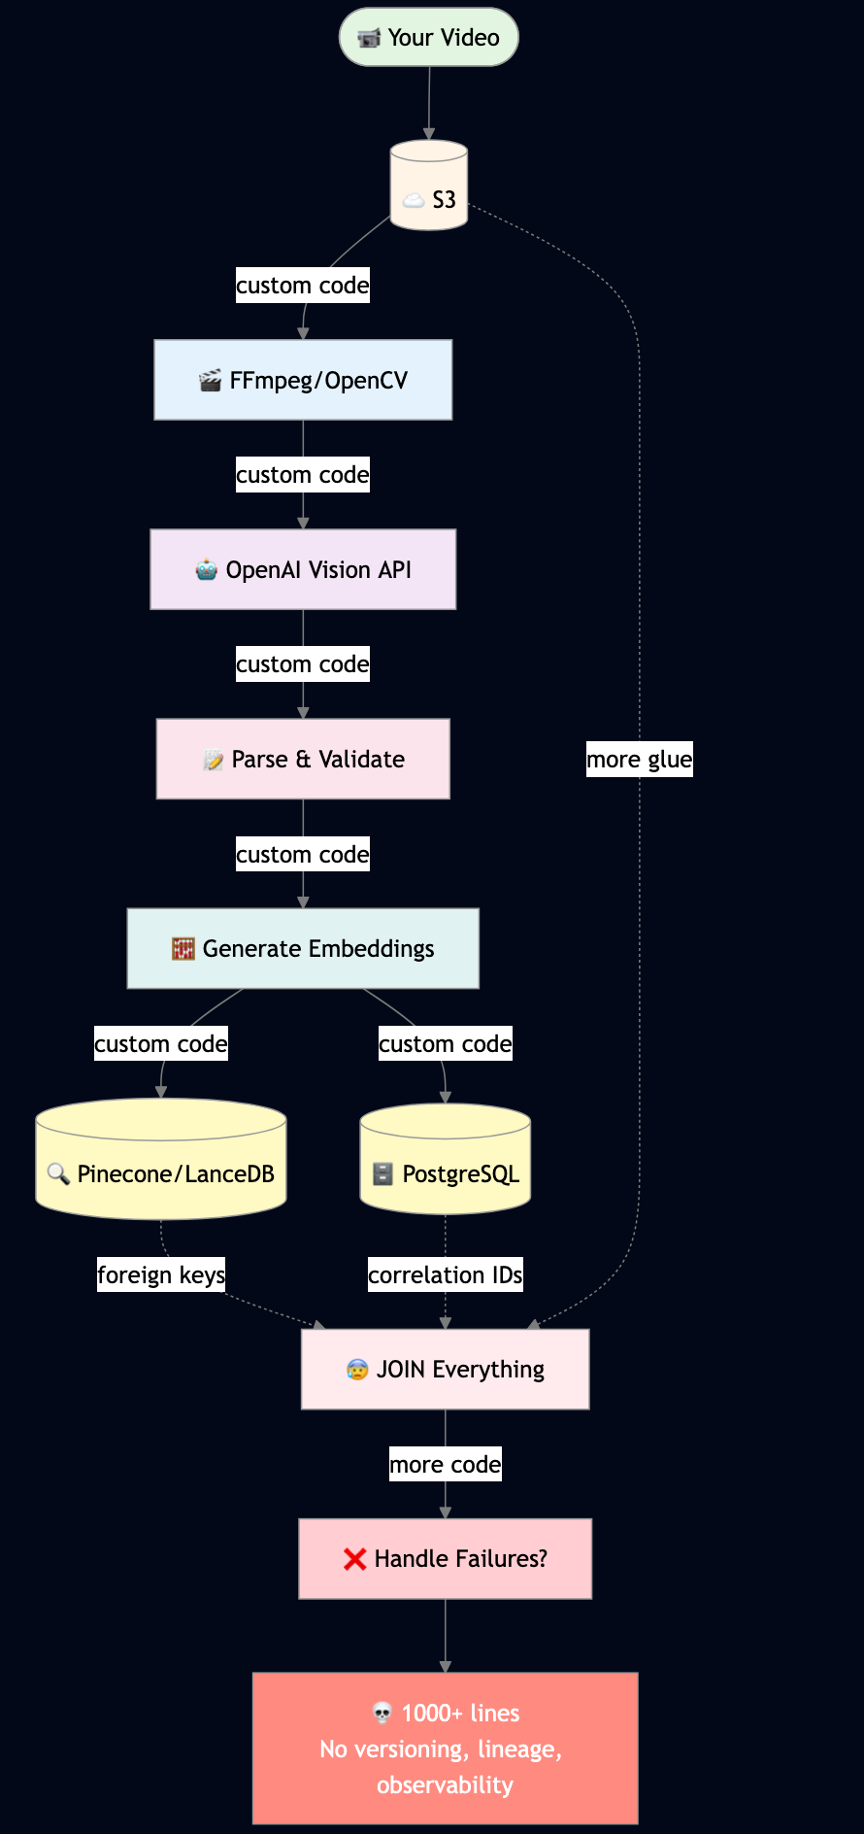
“I want to make a searchable collection of videos”
Example stack:
Upload videos to S3 for storage
Extract frames with FFmpeg/OpenCV
Send frames to OpenAI Vision API, handle retries
Parse responses, validate JSON
Generate embeddings from responses
Store embeddings in Pinecone/LanceDB (for search) + results in PostgreSQL (for queries)
JOIN data across S3, Pinecone/LanceDB, and PostgreSQL with foreign keys and correlation IDs
Handle failures across all of this... somehow?
→ 1000+ lines of glue code and you are still trying to figure out after that how to version, get observability, lineage, scalability, parallelization...

Slide 5
AI development today is
mostly plumbing & pipelines
~ 80-90% of effort

Slide 6
Storage 🗄️
Orchestration ⚙️
What you get:
Videos in S3, embeddings in Pinecone, metadata in Postgres…
Data loaded into memory, exported to file formats
File formats that don’t support media data
Manual tracking of what lives where
What you miss:
Transactions: Models fail halfway → data stays inconsistent
Concurrency: Multiple users → can't work on same data simultaneously
Persistence: Work happens in memory → doesn't map to traditional database schemas
OLTP capabilities: Built for batch → can't serve user-facing requests
What you get:
Custom code wiring tools together
Cron jobs and Python scripts for every step
Manually handling rate limits, retries, chasing API errors
Wild goose chase when requirements change
What you miss:
Dependency tracking: Transforms happen in scripts → hard to trace what depends on what
Low latency/high throughput: Hard to parallelize external API calls → poor performance
Failure handling: Something fails somewhere → rerun
Operational integrity: Inconsistent models for indexing and querying → contaminated index
Notes:
What is the actual problem here- two streams of work

Slide 7
Storage 🗄️
Orchestration ⚙️
What you get:
Videos in S3, embeddings in Pinecone, metadata in Postgres…
Data loaded into memory, exported to file formats
File formats that don’t support media data
Manual tracking of what lives where
What you miss:
Transactions: Models fail halfway → data stays inconsistent
Concurrency: Multiple users → can't work on same data simultaneously
Persistence: Work happens in memory → doesn't map to traditional database schemas
OLTP capabilities: Built for batch → can't serve user-facing requests
What you get:
Custom code wiring tools together
Cron jobs and Python scripts for every step
Manually handling rate limits, retries, chasing API errors
Wild goose chase when requirements change
What you miss:
Dependency tracking: Transforms happen in scripts → hard to trace what depends on what
Low latency/high throughput: Hard to parallelize external API calls → poor performance
Failure handling: Something fails somewhere → rerun
Operational integrity: Inconsistent models for indexing and querying → contaminated index
Notes:
What is the actual problem here- two streams of work

Slide 8
Storage 🗄️
Orchestration ⚙️
What you get:
Videos in S3, embeddings in Pinecone, metadata in Postgres…
Data loaded into memory, exported to file formats
File formats that don’t support media data
Manual tracking of what lives where
What you miss:
Transactions: Models fail halfway → data stays inconsistent
Concurrency: Multiple users → can't work on same data simultaneously
Persistence: Work happens in memory → doesn't map to traditional database schemas
OLTP capabilities: Built for batch → can't serve user-facing requests
What you get:
Custom code wiring tools together
Cron jobs and Python scripts for every step
Manually handling rate limits, retries, chasing API errors
Wild goose chase when requirements change
What you miss:
Dependency tracking: Transforms happen in scripts → hard to trace what depends on what
Low latency/high throughput: Hard to parallelize external API calls → poor performance
Failure handling: Something fails somewhere → rerun
Operational integrity: Inconsistent models for indexing and querying → contaminated index
Notes:
What is the actual problem here- two streams of work

Slide 9
Storage 🗄️
Orchestration ⚙️
What you get:
Videos in S3, embeddings in Pinecone, metadata in Postgres…
Data loaded into memory, exported to file formats
File formats that don’t support media data
Manual tracking of what lives where
What you miss:
Transactions: Models fail halfway → data stays inconsistent
Concurrency: Multiple users → can't work on same data simultaneously
Persistence: Work happens in memory → doesn't map to traditional database schemas
OLTP capabilities: Built for batch → can't serve user-facing requests
What you get:
Custom code wiring tools together
Cron jobs and Python scripts for every step
Manually handling rate limits, retries, chasing API errors
Wild goose chase when requirements change
What you miss:
Dependency tracking: Transforms happen in scripts → hard to trace what depends on what
Low latency/high throughput: Hard to parallelize external API calls → poor performance
Failure handling: Something fails somewhere → rerun
Operational integrity: Inconsistent models for indexing and querying → contaminated index
Notes:
What is the actual problem here- two streams of work

Slide 10
What is the actual problem here?

Slide 11
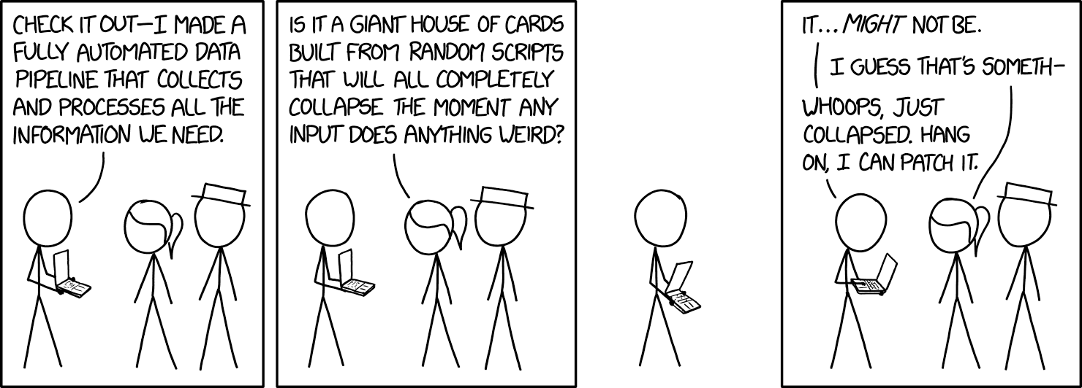
https://xkcd.com/2054

Slide 12
Storage 🗄️
Orchestration ⚙️
Databases store data.
Orchestration tools run transformations.
Notes:
What is the actual problem here- two streams of work

Slide 13
Storage 🗄️
Orchestration ⚙️
Databases store data.
Orchestration tools run transformations.
🤕
😖
Notes:
What is the actual problem here- two streams of work

Slide 14
Pixeltable is both
Storage 🗄️
Orchestration ⚙️
Stored data as inputs
Databases store data.
A database system that knows
how to store and create data.
Orchestration tools run transformations.
An orchestration system that knows how to run transformations and where to put the data.
Generated data as outputs

Slide 15





Pixeltable is both storage and orchestration + a table API
Storage 🗄️
Orchestration ⚙️
summarize w/
OpenAI gpt-4o-mini
extract audio
embedding
[0.2, 0.8, ...]
[0.3, 0.7, ...]
[0.1, 0.9, ...]
s3_file
idx
video_clip
audio_chunk
text
Are you watching closely?
The world has changed.
The dream is always the same.
summary
transcribe w/
OpenAI Whisper
generate multimodal embeddings w/ OpenAI CLIP model
Notes:
Make the heading row with the specifics of the transform

Slide 16
Concrete example:
Making sense of videos

Slide 17



How to make video content searchable
Audio
Transcripts
Start here:
Raw video
Frames
Notes:
Not about better ways to do embeddings- we make it easier to use these kinds of libraries successfully

Slide 18

How to make video content searchable
Summary
Summary
Start here:
Raw video
Summary
Embedding
Embedding
Embedding
Notes:
Not about better ways to do embeddings- we make it easier to use these kinds of libraries successfully

Slide 19
How does Pixeltable solve this problem?

Slide 20
How to make video content searchable
video | audio | transcript
Start here:
Raw video
Notes:
Not about better ways to do embeddings- we make it easier to use these kinds of libraries successfully

Slide 21
Create views in a hierarchy & compute new columns
video | audio_chunk
View #1
video | audio | transcript
video | audio_chunk | text | index
View #2
video | frame | index
View #3
Notes:
Not about better ways to do embeddings- we make it easier to use these kinds of libraries successfully

Slide 22

Insert to populate new rows with computed columns
video | audio_chunk
View #1
video | audio | transcript
video | audio_chunk | text | index
View #2
video | frame | index
View #3
Notes:
Not about better ways to do embeddings- we make it easier to use these kinds of libraries successfully

Slide 23
Pixeltable: The Technical Details

Slide 24
Unified Data Storage, Retrieval and Orchestration
Users: ML engineers, data scientists, software engineers who are building AI data products
Design Goals:
covers all data + orchestration, from experimentation to serving no time spent on engineering data plumbing
Design Principles:
data and transformation logic are organized into tables all data interactions are declarative complete freedom w.r.t. algorithms, models, best practices
Implementation:
Open Source Python library (Apache 2.0) complemented with a cloud service
Notes:
focus on data products: not an end-to-end tool for creating apps w/ UI, etc.
design goals
data plumbing is often the most time-consuming part of engineering data products
and the least differentiated
observability
what did i actually get back from the llm, etc.
how is my product performing?

Slide 25
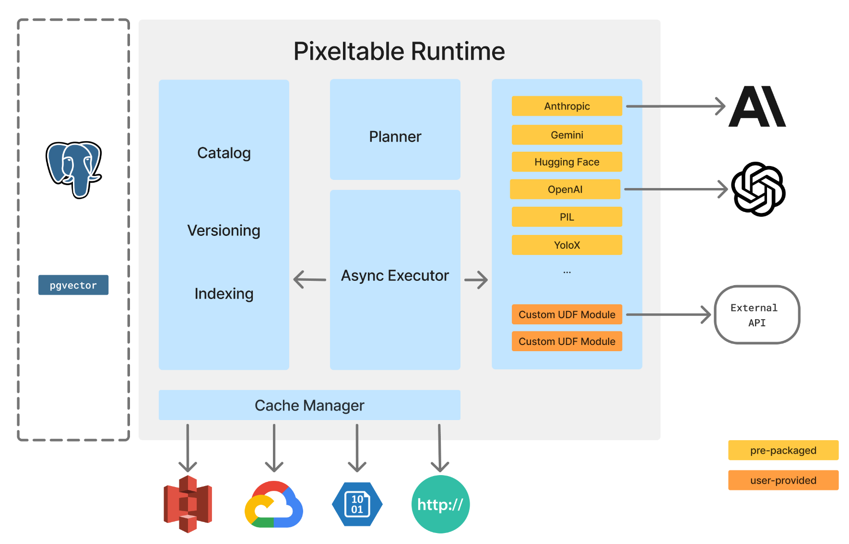
The Local Pixeltable Runtime

Slide 26
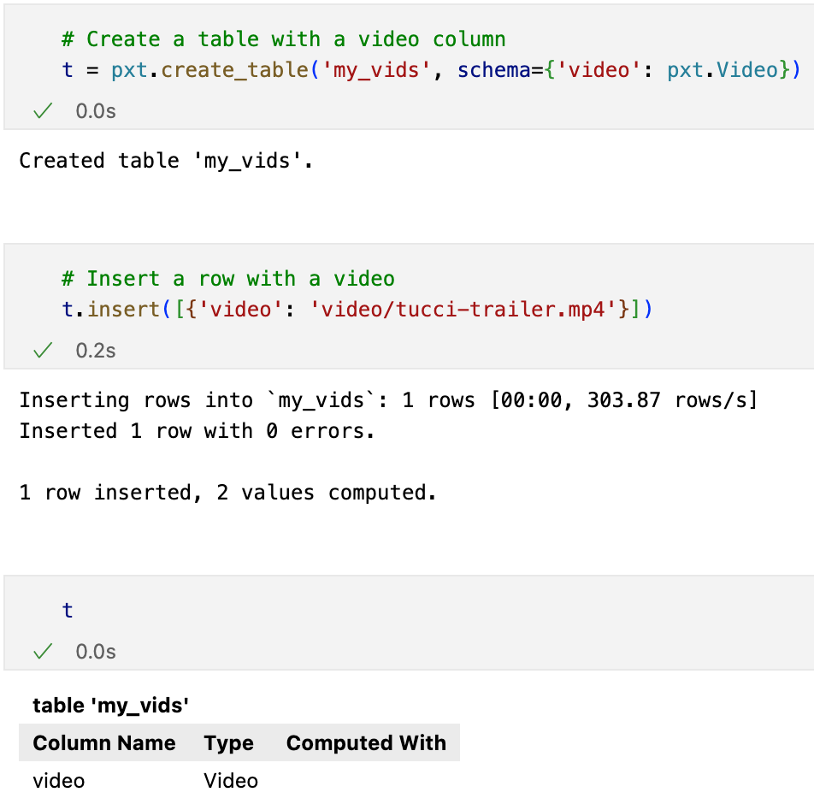
Storing Multi-Modal Data
Tables Persistent Transactional
Data types
standard scalar data (ints, floats, …) media data (docs, videos, images, …) ML-specific: arrays, JSON
Fully functional database system
Notes:
can store any kind of data useful for data product; no need to dump data into external system and then store references
fully functional database system
concurrency
transactions
out-of-memory execution
caches external media data
goal: capture all data relevant for AI data products

Slide 27
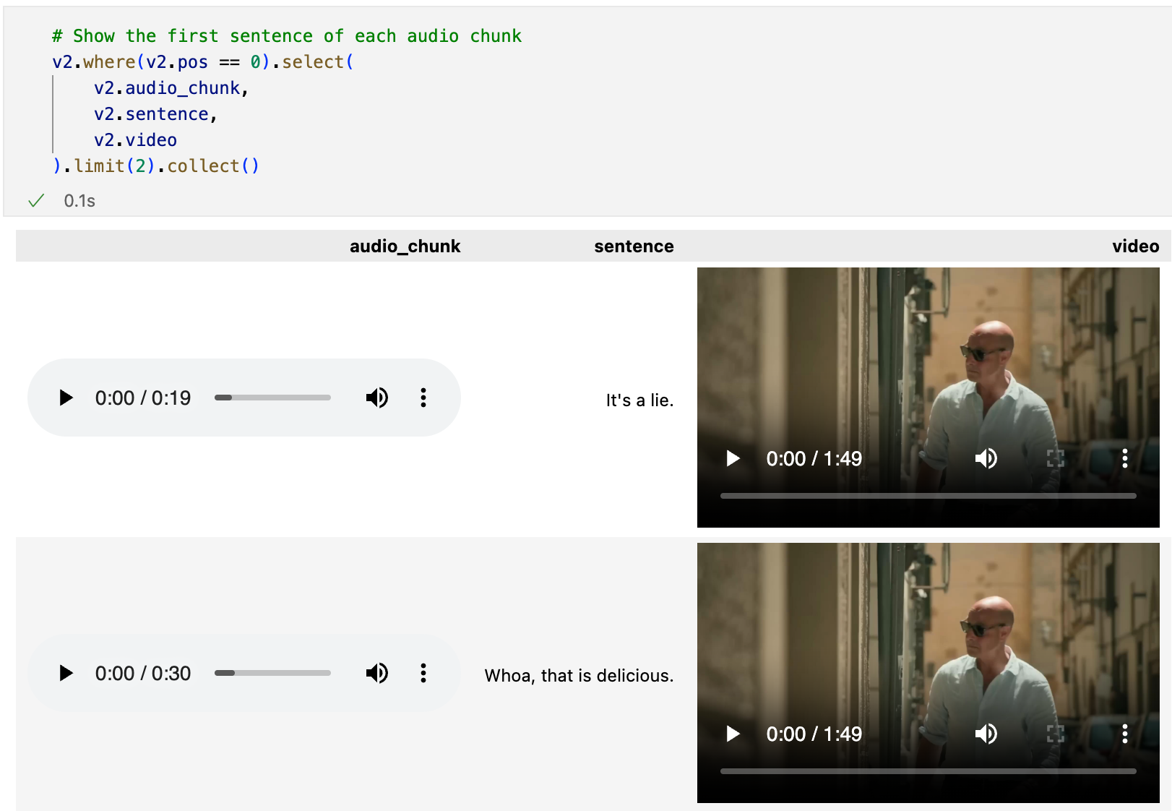
Retrieving Multi-Modal Data
Comprehensive query language
Standard relational operator (select(), where(), join(), etc.)
JSON path expressions transformations
Execution SQL where possible Python where needed
Notes:
can express any kind of transformation or retrieval; no need to dump data out and run script over it
supports all standard query operators: where(), select(), join(), order_by(), group_by()
json path expressions
json is a very common data type
need to be able to query and transform it without having to dump it out and resort to scripts
queries translated into execution plans that include Select stmt against Postgres, plus additional in-memory execution of Python logic

Slide 28
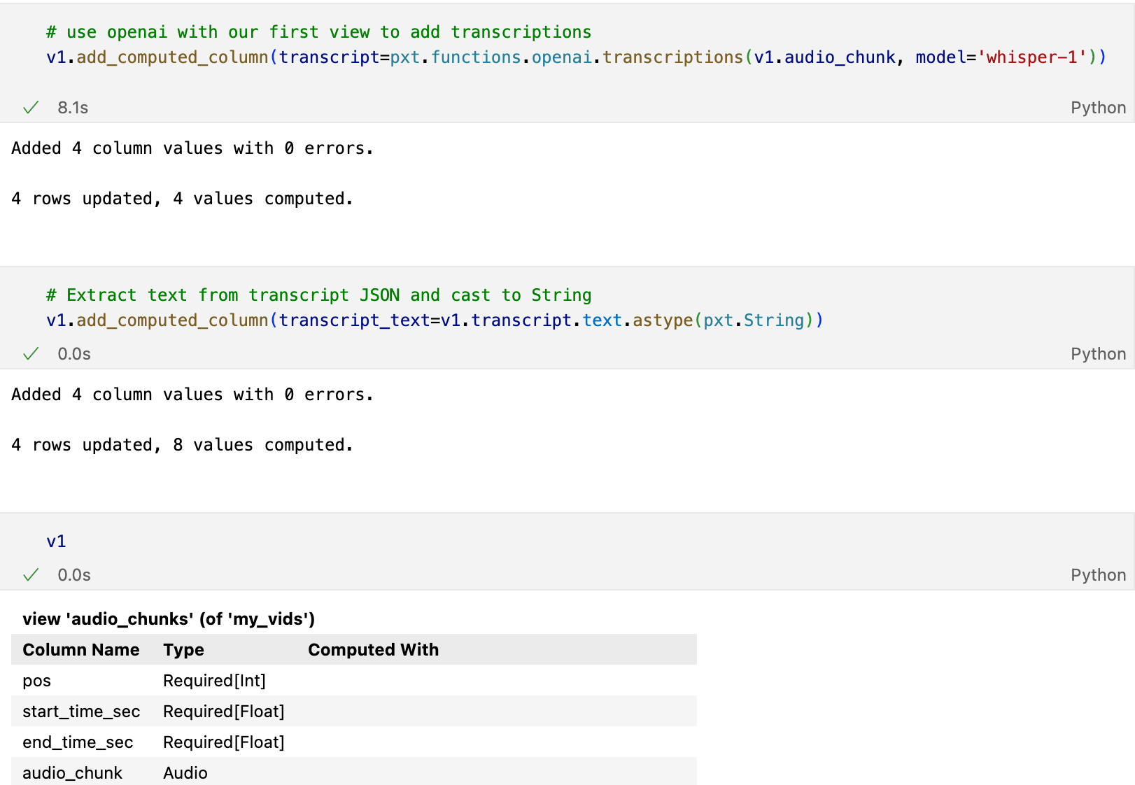
Orchestration: Concepts
Execution logic through table operations and computed columns
Pixeltable maintains table structure automatically and incrementally
Maximal parallelization derived from DAG
Notes:
core concepts
execution logic (transformations, model inference, …) is embedded into table structure as computed columns
data updates (insert/update/delete) maintain table structure automatically and incrementally
schema updates (adding a column) is also incremental
today with eager materialization
analogy: spreadsheet
show cells w/ output

Slide 29
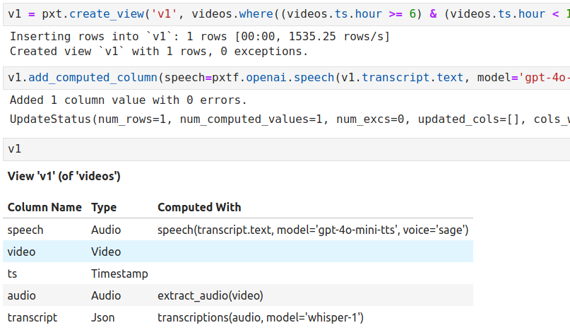
Orchestration: Conditional Data Flows
Declarative data flows/transformations
Maintained automatically and incrementally by Pixeltable
Data lineage = observability
Notes:
views are materialized
view structure is also maintained automatically and incrementally
m_v.audio: implicit join to parent
views with filters express lineage
views let you define complex conditional data flows declaratively, via filters
Iterator views: lateral join explode

Slide 30
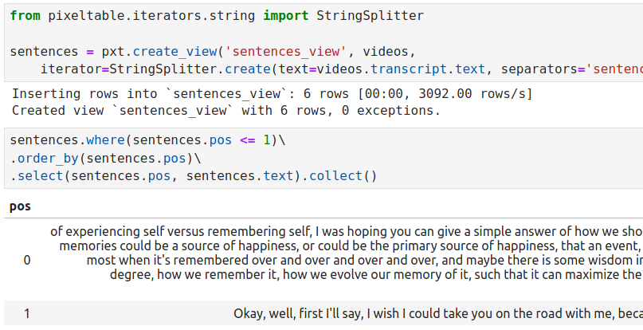
Orchestration: Lateral Views
Iterator Views
from videos to frames from documents to text chunks from larger object to components…
Notes:
entire tree of views is maintained incrementally and automatically
other examples
audio chunking
medical image tile iterators

Slide 31
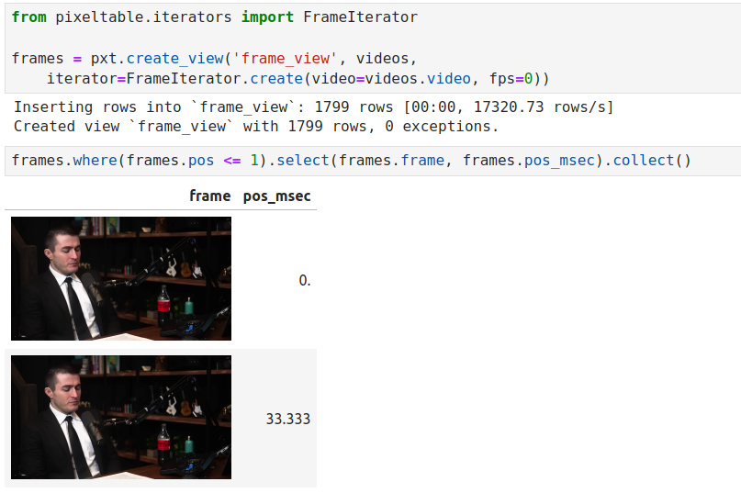
Example: Lateral Views for Video
Frame-level view of videos
Pre-materialization vs. runtime re-materialization
Notes:
runtime materialization of frames; otherwise completely non-scalable size explosion

Slide 32
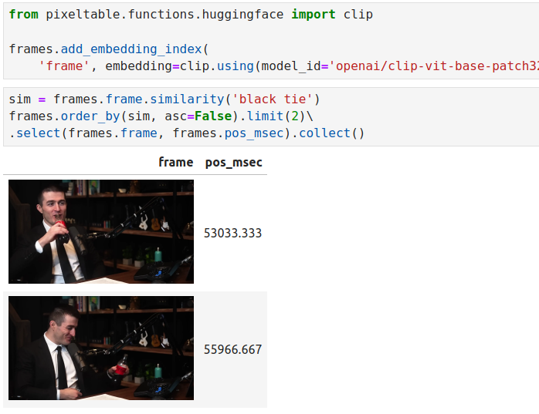
Indexing (a feature; not a product)
Declarative indexes
Multi-modal embeddings/vectors B-trees …
Maintained automatically and incrementally by Pixeltable
Similarity search is part of the query language, not a separate API.
Notes:
feature of Pixeltable; not a stand-alone product
indexes can be added declaratively to any column
possibly multiple indices on a column; example: re-ranking of different retrieval methods
data updates are reflected in indexes automatically and incrementally
similarity search is part of the query language
use multimodal example; index an image or use an image to search
show example with additional predicates; faceted search
vector indexing is a feature of Pixeltable, not a stand-alone product or api

Slide 33
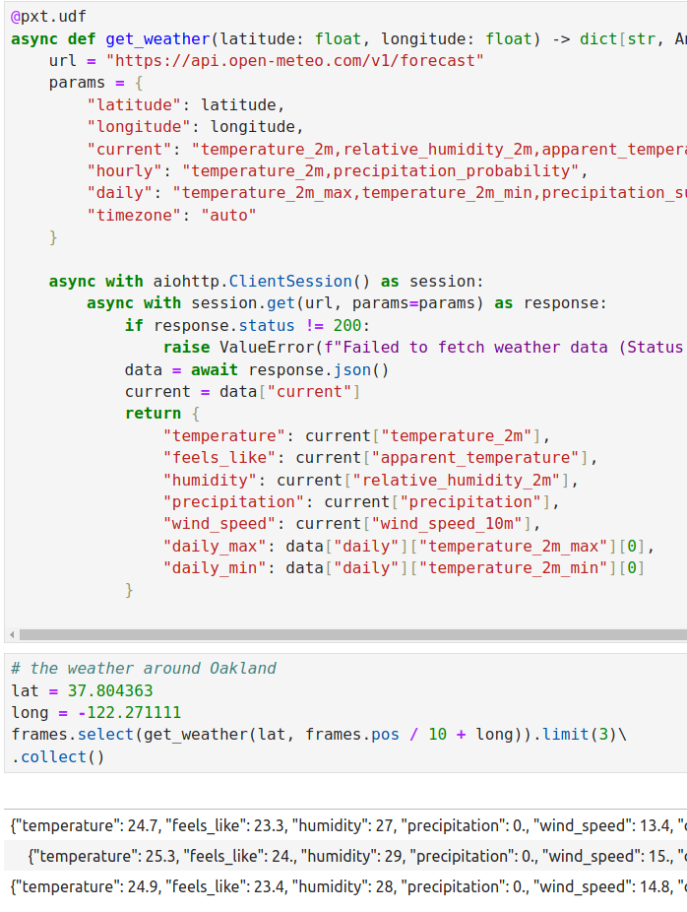
User-Defined Logic
“Bring your own algorithm”:
@pxt.udf User-defined (sync/async) functions
@pxt.uda User-defined aggregates User-defined iterators
Notes:
a Python function (or async function) can be turned into a Pixeltable function with the udf decorator
parameters and return value need to be compatible with Pixeltable’s column types
Pixeltable has a lot of pre-packaged udfs: popular external API services like Anthropic, OpenAI, etc.
popular packages, eg, Pillow
covers broad spectrum of computational patterns
ex.: object tracking as window function
iterator = table-generating function

Slide 34
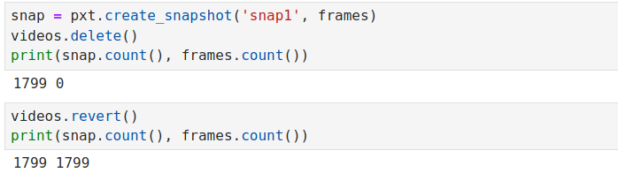
Versioning: Reproducibility & Experimentation
Linear version history
Every update (schema or data) creates a new version
Named snapshots
revert()
Notes:
all schema and data changes are transactional
all schema and data changes are versioned
linear version history, no branches
versions are stored incrementally/differentially
eg, 10 snapshots don’t require 10x storage
named snapshots: query like any table
revert() lets you go back to the previous version

Slide 35
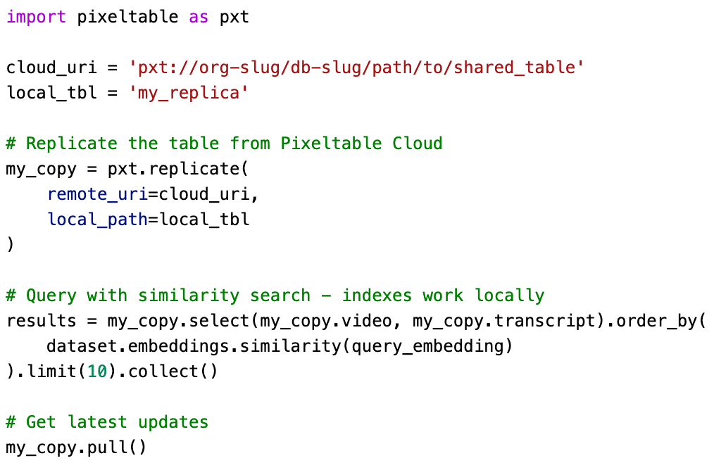
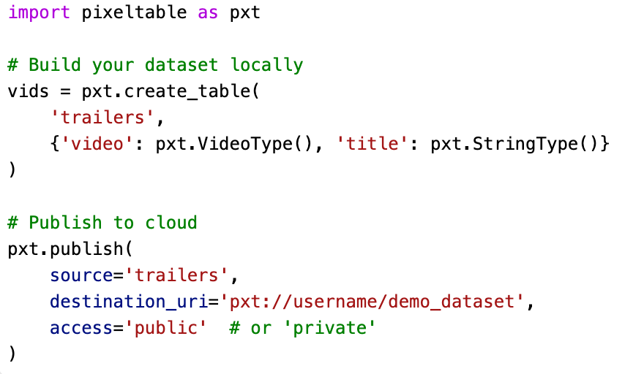
Pixeltable in the Cloud
Data sharing Replicate tables to and from the cloud
Cloud execution Hosted tables via the SDK
Notes:
tables/views/snapshots can be replicated to and from the cloud
includes media data
github analogy
in beta, to be released in a few weeks
cloud execution for cloud-hosted tables via the SDK

Slide 36
Key Takeaways
Single system for all data storage Structured data, media data, ML-specific data
Single API for all data access Simple, intuitive, tabular
Observability is built in Table = log Schema = orchestration
Efficiency and parallelization Declarative API enables cost-based optimization, fine-grained parallelization
Notes:
tables/views/snapshots can be replicated to and from the cloud
includes media data
github analogy
in beta, to be released in a few weeks
cloud execution for cloud-hosted tables via the SDK

Slide 37
Get Started with Pixeltable
Locally pip install pixeltable
Cloud Sign up for our Pixeltable Cloud preview at pixeltable.com/waitlist
Repo https://github.com/apreshill/pxt-tucci/

Slide 38
Resources
Pixeltable
Github: github.com/pixeltable/pixeltable Sample Apps: docs.pixeltable.com/docs/examples/use-cases MCP Servers: github.com/pixeltable/pixeltable-mcp-server
Pixelagent
Proof-of-concept implementation of agent framework on top of Pixeltable Compact: only a few 100 lines of code Utilizes Pixeltable for storage, memory, retrieval, tools, orchestration, observability… Github: github.com/pixeltable/pixelagent
Pixelbot
Sample implementation of a multimodal AI agent with infinite memory Handles documents, images, audio, videos uploads/storage/indexing/retrieval Leverages tools, Claude Sonnet 3.5, OpenAI Whisper, Mistral Small. Hosted at agent.pixeltable.com
Notes:
Pixelagent
proof-of-concept implementation of agent framework
utilizes Pixeltable for memory, retrieval, orchestration, observability
compact: few hundred lines of code
easy to start with to create your own custom agent framework
https://github.com/pixeltable/pixelagent
Pixelbot
sample implementation of a multi-modal AI agent with infinite memory
hosted at <url>

Slide 39
Thank you!
Questions? Comments?
Come see me at office hours or at the booth!
marcel@pixeltable.com
Notes:
Pixelagent
proof-of-concept implementation of agent framework
utilizes Pixeltable for memory, retrieval, orchestration, observability
compact: few hundred lines of code
easy to start with to create your own custom agent framework
https://github.com/pixeltable/pixelagent
Pixelbot
sample implementation of a multi-modal AI agent with infinite memory
hosted at <url>

Slide 41
Pixeltable is a fully functional database system
You don’t have to worry about bringing in to memory and then which file format to export to
It is a table API

Slide 42
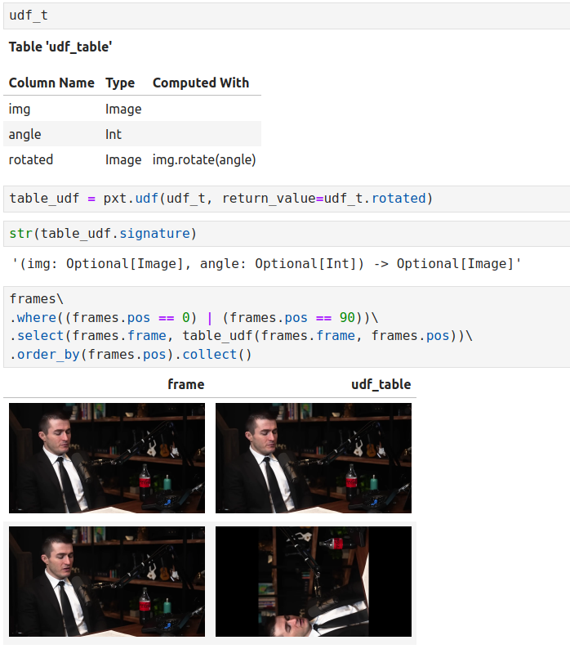
Table-as-UDF
Composition of complex processing pipelines
Table-derived UDF
parameters: input columns returns: computed columns
Notes:
udf will be the unit of serving

Slide 43
================================================================================
PIXELTABLE: MULTIMODAL TABLE ARCHITECTURE
================================================================================
Table: "videos"
+--------+----------+-------------+-------------+---------------------+
| id | video | frames | transcript | embedding |
|(store) | (ref) | (computed) | (computed) | (computed) |
+--------+----------+-------------+-------------+---------------------+
| 1 | 🎬 [MP4] | 🖼️ [1000] | "Hello..." | [0.2, 0.8, ...] |
| 2 | 🎬 [MP4] | 🖼️ [800] | "Welcome" | [0.3, 0.7, ...] |
| 3 | 🎬 [MP4] | 🖼️ [1200] | "Today..." | [0.1, 0.9, ...] |
+--------+----------+-------------+-------------+---------------------+
| | | |
| | | |
| v v v
| FrameIterator Whisper OpenAI Ada-002
| extract_frames transcribe embed_text
|
+---> Dependency Chain: Automatic Propagation
================================================================================

Slide 44
Your one stop shop for developing AI-based data products
Complete - capture all the data you need, doesn’t limit what you do with the data
Store of record - don’t need separate place
[ ] - express any transformation or other application logic
→ Complete - real production is multi user
→ Complete - real AI use cases require captures all the data types
→ Complete - augment it

